Slide 1
PacificSource Partnering with
Montana Nonprofit Association

Slide 2
The health plan that’s
Doing what’s right, not just what’s required

Slide 3
Our purpose is helping members and their communities achieve better health, better care, and better cost.

Slide 4
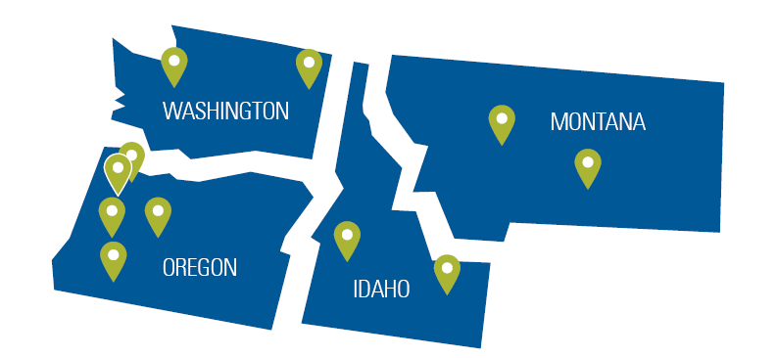
1
PacificSource:
A trusted lifelong partner
PacificSource employs more than 1,900 people in four states. Together with our partners, we serve members nationwide.

Slide 5
Stability across time
$3.8billion
Founded
Annual revenue
FY 2023
A-
(Excellent)
AM Best rating 2023 report
Membership 640,519 Enrollment report, April 2024
Lines of business
Individuals and families
Small and large employers
Medicaid
Medicare
FSA, HRA, and COBRA
PacificSource Health Plans | PacificSource Community Health Plans | PacificSource Community Solutions | PacificSource Administrators, Inc.

Slide 6
Being not-for-profit keeps our focus where it belongs: on the health of our members and the communities we share.

Slide 7
2
Serving members and communities
Healthy Communities Program
PacificSource Foundation for Health Improvement*
*The PacificSource Foundation for Health Improvement is an independent, private foundation, not connected to any PacificSource entity.

Slide 8
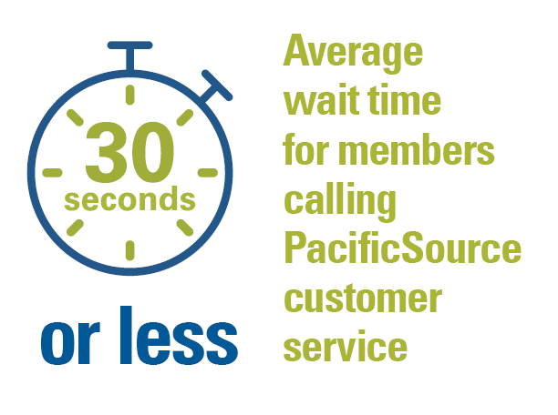
3
Improving the healthcare experience
An emphasis on human service

Slide 9
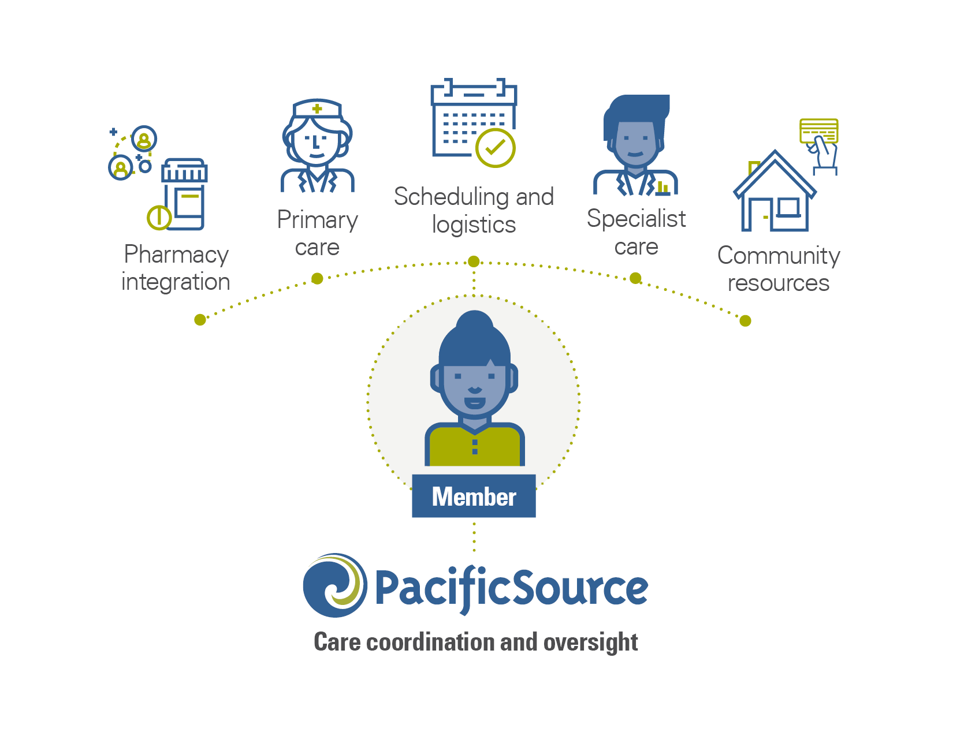
Members experience seamless, accountable care from a dedicated team of providers

Slide 10
4
Making healthcare easier
As of May 2023
Our provider networks:
With a wide range, depth, and a focus on quality

Slide 11
The Navigator network ̶̶ Montana
We partner with highly rated local providers, including:

Slide 12
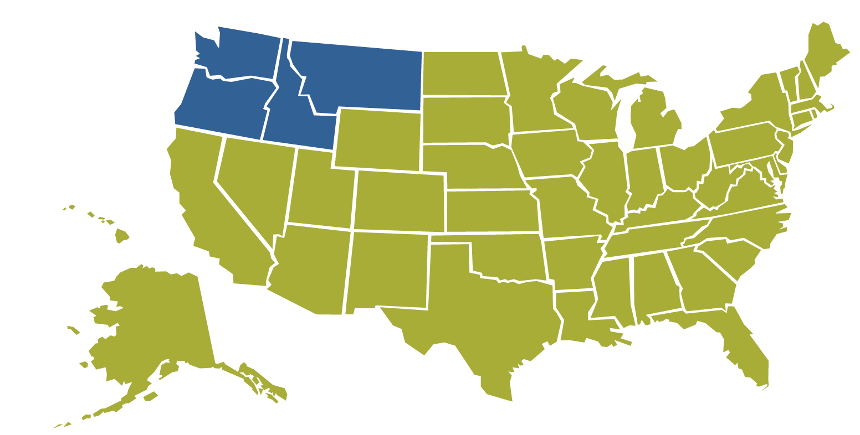
Beyond the Northwest, in-network care is available through our collaboration with Aetna Signature Administrators.®
Our four-state provider network
In-network care through

Slide 13
Small group HSA-eligible plans
Plan Name | Deductible | OOP | PCP OV / Spec | Coinsurance | Rx Benefit
Bronze HSA 8050 | $8,050 | $8,050 | After deductible 0% | After deductible 0% | After deductible 0%
Silver HSA 5500 | $5,500 | $5,500 | After deductible 0% | After deductible 0% | After deductible 0%
Silver HSA 5100 | $5,100 | $5,100 | After deductible 0% | After deductible 0% | After deductible 0%
Silver HSA 3500 | $3,500 | $7,500 | After deductible 20% | After deductible 20% | After deductible 20%
Gold HSA 3400 | $3,400 | $3,400 | After deductible 0% | After deductible 0% | After deductible 0%

Slide 14
Federal HDHP limitation updates
 | 2023 |  | 2024 | 2025
HSA: Individual
Contribution limit | $3,850 |  | $4,150 | $4,300
Annual OOP max | $7,500 |  | $8,050 | $8,300
HSA: Family
Contribution limit | $7,750 | $7,750 | $8,300 | $8,550
Annual OOP max | $15,000 | $15,000 | $16,100 | $16,600

Slide 15
Small group copay-style plans
Plan Name | Deductible | OOP | PCP OV / Spec | Coinsurance | Rx Benefit
Bronze 9200* | $9,200 | $9,200 | $60 / $120 | After deductible 0% | $30, $100, $200, $500
Bronze 7500 | $7,500 | $9,200 | $40 / $100 | After deductible 30% | After deductible 30%
Silver 6500* | $6,500 | $9,100 | $30 / $60 | After deductible, 30% | $15, $60, $100, $250
Silver 5500* | $5,500 | $9,100 | $30 / $60 | After deductible, 30% | $15, $60, $100, $250
Silver 4500* | $4,500 | $9,100 | $35 / $70 | After deductible, 30% | $15, $60, $100, $250
Silver 3000 | $3,000 | $9,200 | $30 / After deductible $60 | After deductible, 40% | $15, $60, $100, $250
* Indicates plan is also offered with adult vision.

Slide 16
Small group copay-style plans
Plan Name | Deductible | OOP | PCP OV / Spec | Coinsurance | Rx Benefit
Gold 3000* | $3,000 | $5,500 | $35 / $70 Includes PT/ST/OT copay | 30% | $10 / $35 / $60 / $250
Gold 2000* | $2,000 | $6,500 | $30 / $60 | 30% | $10 / $35 / $60 / $250
Gold 1000* | $1,000 | $6,500 | $30 / $60 | 30% | $10 / $35 / $60 / $250
Platinum 500* | $500 | $3,000 | $10 / $20 | 20% | $5 / $15 / $50 / $250
*Indicates plan is also offered with adult vision.
Dental plans are available with a range of plan options.
Pediatric dental is embedded in small group plans for enrolled members through age 19.

Slide 17
Flexible Spending Accounts
 | 2023 | 2024 | 2025
FSA:
Health FSA Max | $3,050 | $3,200 | $3,300
Health FSA Carryover Max | $610 | $640 | $660
FSA: Dependent Care
Dependent Care Assistance Plans Max (single or married filing jointly) | $5,000 | $5,000 | $5,000
Dependent Care Assistance Plans Max (married filing separately) | $2,500 | $2,500 | $2,500

Slide 18
Comprehensive pharmacy services
Clinically effective pharmacy care with:
Integrated with our medical benefits
Lowest net cost
High quality
Outstanding member satisfaction

Slide 19
PacificSource Pharmacy Services
Value Based Preventive Drug List
Early detection of health status via shared clinical data
Integration with Health Services and Case Management
Single source of customer service for medical and pharmacy
Dedicated, in-house pharmacists and technicians

Slide 20
Achieving lowest net cost
PMPM Cost
Based on independent benchmarking data from Q1 through Q3 of 2023.

Slide 21
About PacificSource Administrators
Excellent Customer Service | Mobile App | Premium-Only Plans | Flexible Spending Account
Health Reimbursement Arrangement | Prepaid Benefit Card | COBRA Administration | Transportation Benefit

Slide 22
Benefits of bundling PacificSource w/ PSA
Annual and Implementation fee waived
Cross trained Customer Service to assist with claim filing or resolution
EasyPay functionality (‘set it and forget it’)
FSA/HRA portal accessible via InTouch for Members

Slide 23
Value-added programs
InTouch
myPacificSource App
Member Support Specialist
Condition support
Teladoc®
Optum HouseCalls
Active&Fit Direct™ program
Assist America®
Weight Watchers®
Health education classes
PacificSource prenatal program
Accordant ® rare disease program

Slide 24
Additional accident benefit
Included on all nonstandard individual and small group plans; available on large group plans.
Caused through external and accidental means.
“Accident” means an unforeseen or unexpected event causing injury that requires medical attention.
Excludes: sprains/strains obtained while performing a physical activity, injuries related to disease or frailty.

Slide 25
No-cost, in-home or telehealth health and wellness visits
PacificSource partners with Optum HouseCalls to offer in-home and telehealth health and wellness visits
No cost to member for assessment
The home assessments are provided by nurse practitioners.
Voluntary—we encourage PacificSource members to participate
Members who qualify are sent information in advance to set up an appointment.
Part of our ongoing quality improvement activities

Slide 26
Teladoc | additional access to care
Access Anytime Provide 24/7, on-demand access to board-certified providers by video, phone, or mobile app. | Services Offered Behavioral health and general medical coverage available. | Treat Health Issues Diagnose, treat, and prescribe medications (if necessary) for common health issues.

Slide 27
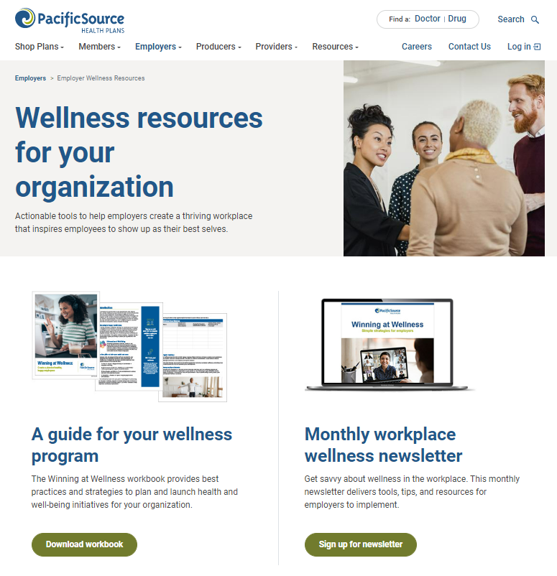
Wellness in the Workplace | Employer Resources
Available resources to employer groups of all sizes:
Quarterly newsletter directed for organizational and wellness leaders
Comprehensive guide to support launching or managing a wellness program
80+ Wellness Toolkits, which are grab and go articles to support well-being awareness.
Webinars that offer solutions for successful organizational wellness
PacificSource.com→ Employers→ Wellness→ Wellness Resources

Slide 28
InTouch for Employers Overview
Manage eligibility for benefit-eligible employees
Maintain accurate demographic information
Manage open enrollment
Access benefit information for employee plans
Make payments or set up automatic payments
Run reports
Order and print ID cards
And more.

Slide 29
Who are Member Support Specialists?
Nonclinical staff who are an integral part of our care management team; they provide support to our members and community providers.
They work either by phone or in-person (depending on location) to support our members with any social-determinant health needs.
Their goal is to break down any barriers our members are up against when adhering to medical regimens—that will ultimately achieve optimal health outcomes.

Slide 30
Examples of member support
Housing – Help connecting members with ways to pay rent, mortgage, or other housing related costs
Food – Help arranging meal delivery services to keep members from going hungry
Transportation – Help getting rides to and from doctor’s appointments
Utilities – Help getting clean water, electricity, or heat by connecting members with aid for utility bills, firewood, and more
Equipment – Help getting all the things a member would need to help with their medical care, from crutches to wheelchairs to CPAP machines to blood glucose monitors

Slide 31
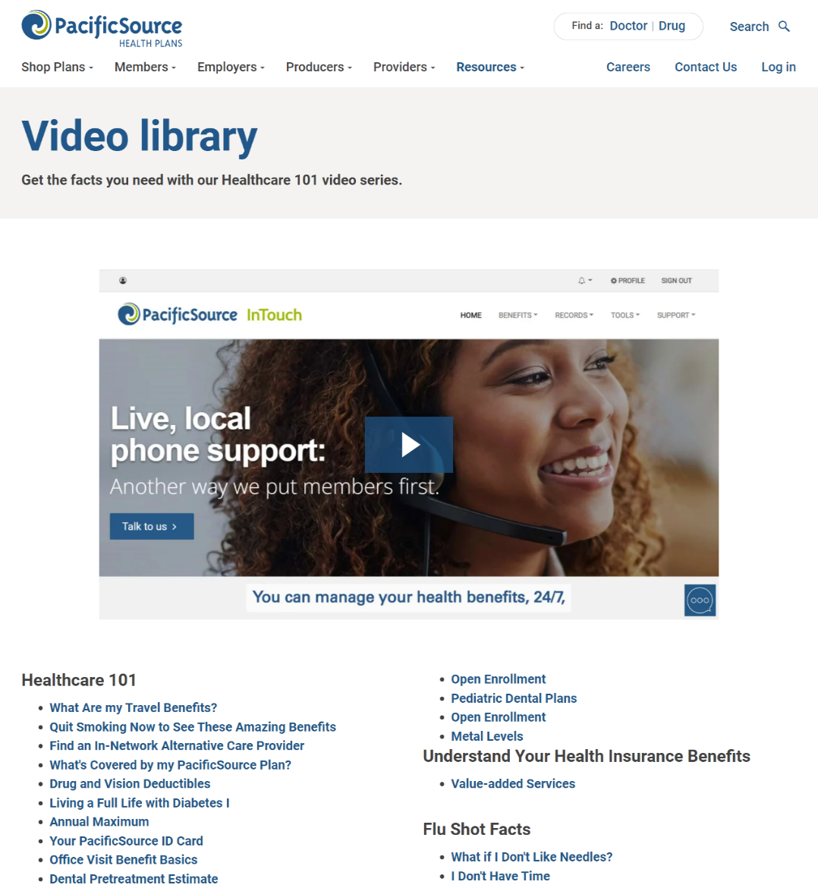
Empowering members with on-demand info
More than 45 brief easy-to-understand videos:
Logging into InTouch
Healthcare 101
Common health insurance terms
Flu shot facts
And more!

Slide 32
Who to contact. We’re here to help.
Jeff Hasskamp
406-531-5421
Jeff.Hasskamp@PacificSource.com
Nicole Flesch
406-544-0071 Nicole.Flesch@PacificSource.com

Slide 33
Questions

